Slide 1
ANNUAL MEETING
2023
Mt. Gate HOA Board • 05.17.2023

Slide 2
Agenda
Year in review
Board Overview & Election
Financial Update
ACC Update
General Reminders
Previous Initiatives - updates
Monthly Communication
Speed & Safety Committee
Trees
Continuing Initiatives
CC&R Update & HOA Modernization
Community Engagement
Call to Action
Open Discussion and Questions

Slide 3
Board Overview & Changes
President - Matt Kleinke - 2024
Treasurer - Aaron Reiter - 2023
Secretary - Mark Weggeland - 2023
Director 1 - Rob Marreel - 2023
Director 2 - Valerie Senff - 2024
Re-Elected - 2026
Re-Elected - 2026
Re-Elected - 2026
Notes:
Review of the board members (animation down to Valerie)
Thank the board members for stepping up and running again
As of List out that we have received roughly 45% returning a ballet, 96% filled out (4% abstaining) and all voting for candidates or Matt as proxy.
All candidates are here by re-elected to their positions for 3 more years! Show the animation for re-election
As of 5/15/2023
Mark - 29 online, 37 paper, 21 Matt Proxy
Rob - 29 online, 36 paper, 21 Matt Proxy
Aaron - 27 online, 36 paper, 21 Matt Proxy

Slide 4
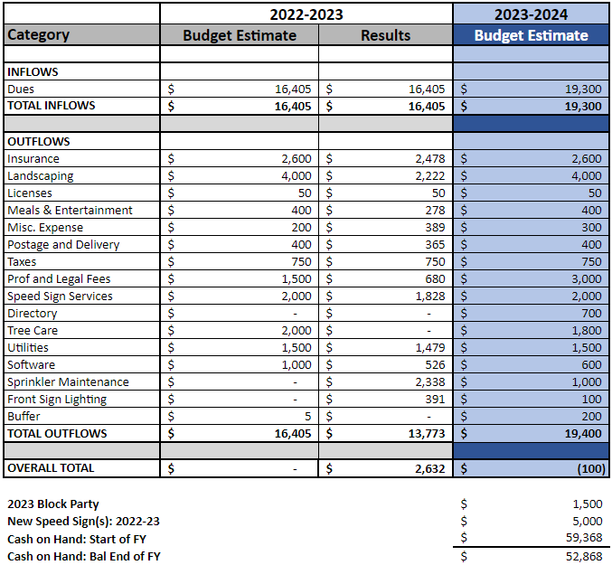
Financial Update - Aaron Reiter

Slide 5
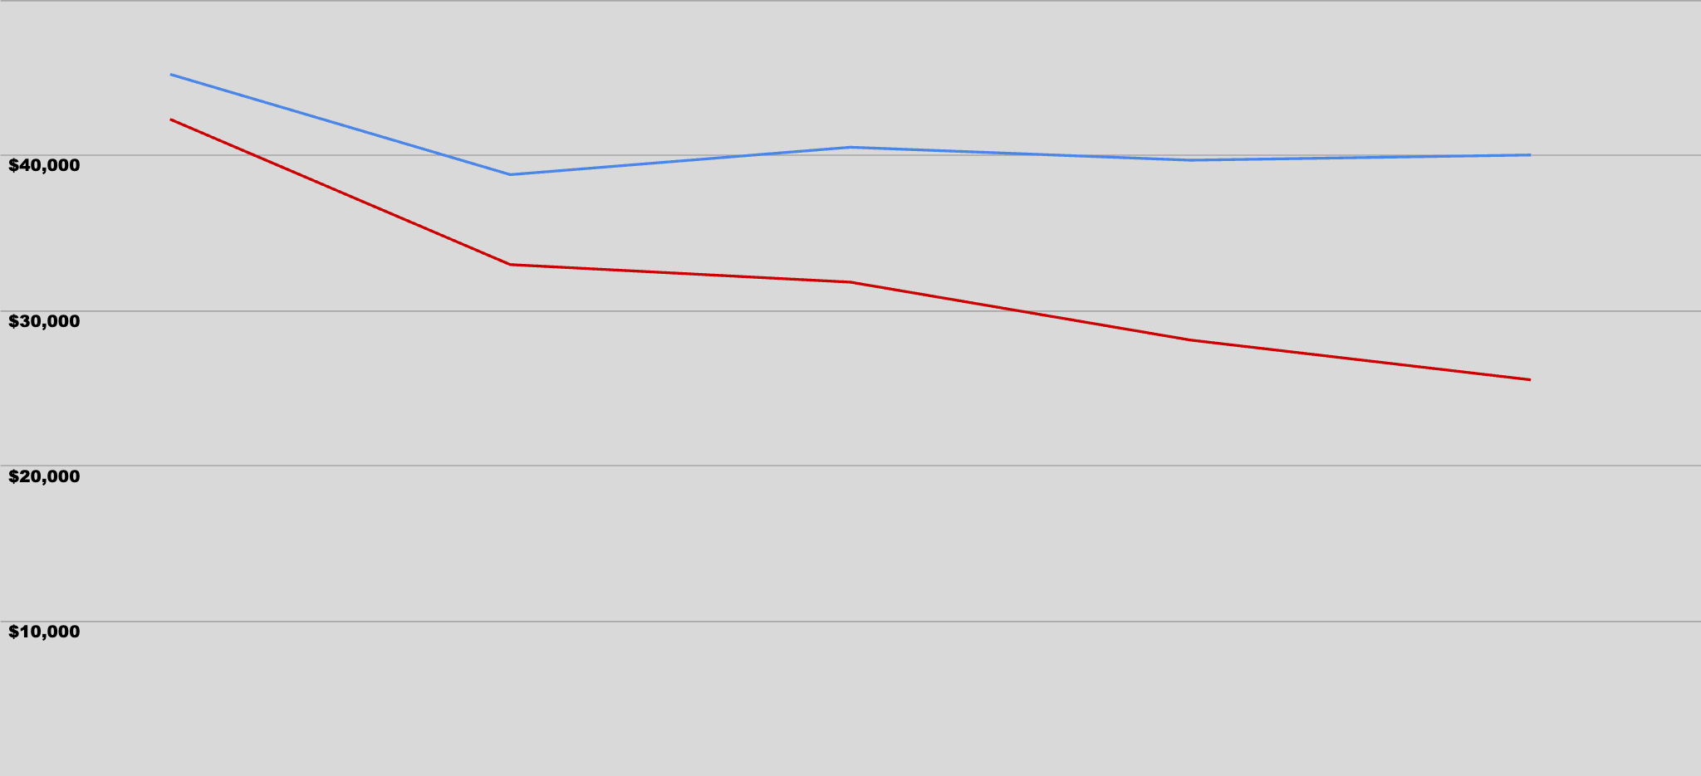
HOA Financial Model
Without increase we go negative over time
Operational Costs Are Increasing
Landscaping / tree maintenance (HOA property)
Infrastructure maintenance (sprinklers, electrical, etc.)
Legal fees
Insurance premiums
Speed Sign
Notes:
What is the increase for?
Are we going to keep the increase?
Concern that we want to remove the $100 cap

Slide 6
ACC Member Update
Thank you Ron!
Thank you Ron Bohart!
Ron served on the ACC for many many years (more than 25).
He gave up his free time and provided his construction experience / expertise to keep Mt. Gate beautiful and maintain our home values.
Ron’s successor is Jason Fehr.
Jason and his family moved into Mt. Gate in 2022.
Jason comes with a background in high end real estate appraisal management and construction.

Slide 7
ACC Update
Members:
Barbara Kleinke
Rob Grabowski
Jason Fehr
Reminders from the ACC:
Send your request to mtngate.tigard@gmail.com
All external changes need to be approved
Some suggestions to make your approval faster
House (re)painting large (min 3x3’) samples need to be applied (all colors used)
Landscaping, decks, patios, paths, sheds, etc. please include a simple sketch and material that will be used
Roof’s - provide color, style, and link to manufacture
Tree’s - non-Maple Street trees - provide type, reason for removal, and location on property. Please also discuss with adjacent neighbor. Street Maples go to board. Remember to remove any stumps which are visible from the street.
ACC has 14 days to respond under CC&Rs. They are usually much faster, but please allow time for the team to review and provide feedback
Request Stats:
2021 - 34 requests
2022 - 40 requests
2023 - 4 YTD requests

Slide 8
ACC Members

Slide 9
General Reminders
Garbage / recycling / yard debris cans - out of sight
Weeds, moss, leaves and other basic yard upkeep
Trailers, RV’s, Campers, Boats, etc.
Signs - only Alarm & For Sale
Construction debris / staging
Work vehicles
Farm Animals (i.e. chickens, roosters, etc.)
The most common CC&R compliance issues
Notes:
No yard sale signs

Slide 10
Previous Initiatives
Monthly email communications
Speed & Safety Committee
Trees
CC&R Update & HOA Modernization
Community Engagement
2021-2023

Slide 11
75%
Monthly email blast and communication - a continued success!
Regular engagement with community on important topics or general reminders.
Subscriber base is now at 205
Not subscribed? Go to: www.mtngate.org/newsletter-signup
The open rate has remained high @
Any additional requests or comments?
Notes:
Point is to bring forward important topics for the community
Keep people informed and engage with the community on a regular basis
Low cost and high impact
Can anyone guess what the open rate is of our email campaigns?

Slide 12
Speed & Safety Committee Update
2021
Concern raised about needing a committee
2022
Committee formed with an initial 3-5 people
Attendance struggled
2023
Due to lack of interest/energy the committee is being disbanded
2021-2023
Notes:
Need to reframe this….committee didn’t work out. Thank you to the participants, but didn’t get enough additional support to operate.
Highlight the board still supporting a new speed sign, with a target date by end of the year to be installed.

Slide 13
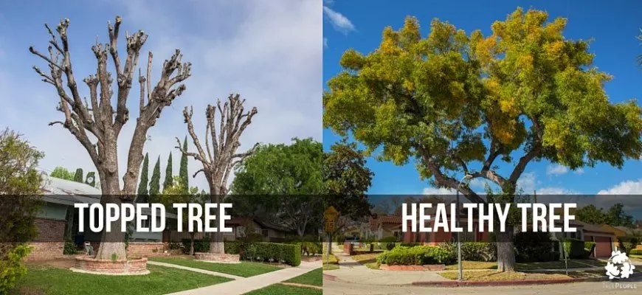
Trees - they make our neighborhood amazing!
Can I remove a tree?
If you want to remove a tree in your yard that is NOT one of the maple street trees you may do so after contacting the ACC and getting approval.
If this is a street tree you will need to contact the board to get approval and come up with a replacement plan.
Can I “top” the maple trees?
No.
Topping the maple trees in Mountain Gate is not allowed and will result in a fine or requirement for you to replace the tree on your property at your expense.
The HOA board is currently evaluating other species of comparable Maple options for homeowners to choose from if a replacement is needed.
Find acceptable trees on HOA website.
The board will use the CC&R’s to enforce proper maintenance, including continuing to review homes in the last few years which have removed street maples without replacing.
Notes:
Tree removal will only be approved if it is diseased and potentially going to cause damage to a structure or was severely damaged in a storm. The street trees must be replaced on the timeline given by the board.

Slide 14
Continued Focus Topics
CC&R Update & HOA Modernization
Community Engagement
2023-2024
Notes:
Old trees - reaching end of their life
Homes reaching the age they need more updates
Ease of communicating with Board and ACC
Responsibility of owners to maintain → was easier 10 years ago than it will be going forward
Safety is on our mind. Young generation with Kids moving in → which is great for the neighborhood.
Want to keep it / make it a neighborhood that is desirable/attractive to today's market.

Slide 15
CC&R’s Update
HOA Modernization
CC&R’s are roughly 30 years old with only minor updates
Our neighborhood demographics are changing, our governance needs to change with it.
Exploring topics such as….
How we communicate within the neighborhood ← i.e. email blasts
How we manage official board communication and revisit fee schedule ← ongoing
Clarification of language around repeat issues ← ongoing
Optional online payment of dues and annual voting ← implemented for 2023 - 2024
Board / ACC functional email addresses ← in development
Proposed changes will be brought to the community for approval as required
We need to future proof our Board so we continue to get volunteers
Improved record keeping and historical documentation
What New Neighbors say:
Beautiful/Maintained
Quiet
Neighborly/Friendly
People Care/Take Pride
Community Managed
Low HOA Fees
This won't Change
Notes:
Cost concerns (initial quotes)
Reviewed CC&Rs
Online payment option and voting
Evaluated HOA management software
Implemented regular email communication —> more informed.

Slide 16
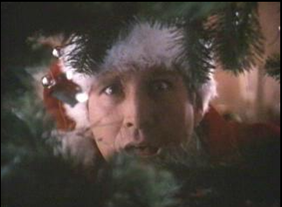
Community Engagement
2019 our first block party was a smashing success!
Covid got in our way in 2021, looking to try again in 2023
2022 Mtn Gate Holiday Night Out was a great success!
Neighbors meeting each other for the first time, enjoying some cider, sweets, fire pit, and of course some wonderful decorations!
2022 the board had discussions with Rep. Courtney Neron
Highlighted concerns about traffic, Bull Mt. Road and sidewalks/crossing, etc.
Let’s keep the community engagement going:
Ever thought about volunteering to help build community engagement?
Got great ideas?
95 homes in our neighborhood put up significant decorations
Many of them out did last year!
How’d you like to help give our neighbors an opportunity flex their festive and community muscles this year?
Let’s light up Mountain Gate!
Contact the HOA Board to Get Involved
Notes:
Holiday party in December went great >50 people attended…..all the cider and hot chocolate was consumed!
Dialogue with local reps about our community - Courtney Neon
Cheer map - 95 homes - similar to last year → a great success. Higher percentage of homes than last year that would make the Griswolds proud!
Entry is now equipped for nice lights this year - tying the community together.
Neighborhood block party - float the idea
Holiday get together again

Slide 17
A Call for Volunteers!
Future ACC members
Looking for a future member
Future Board members
2 Seats up for re-election next year
President and Board Member
Future Committee Members
Community Engagement Activities
Our community only thrives when we all participate

Slide 18
Open Discussion
&
Questions

Slide 19
Thanks for joining

